Slide 1
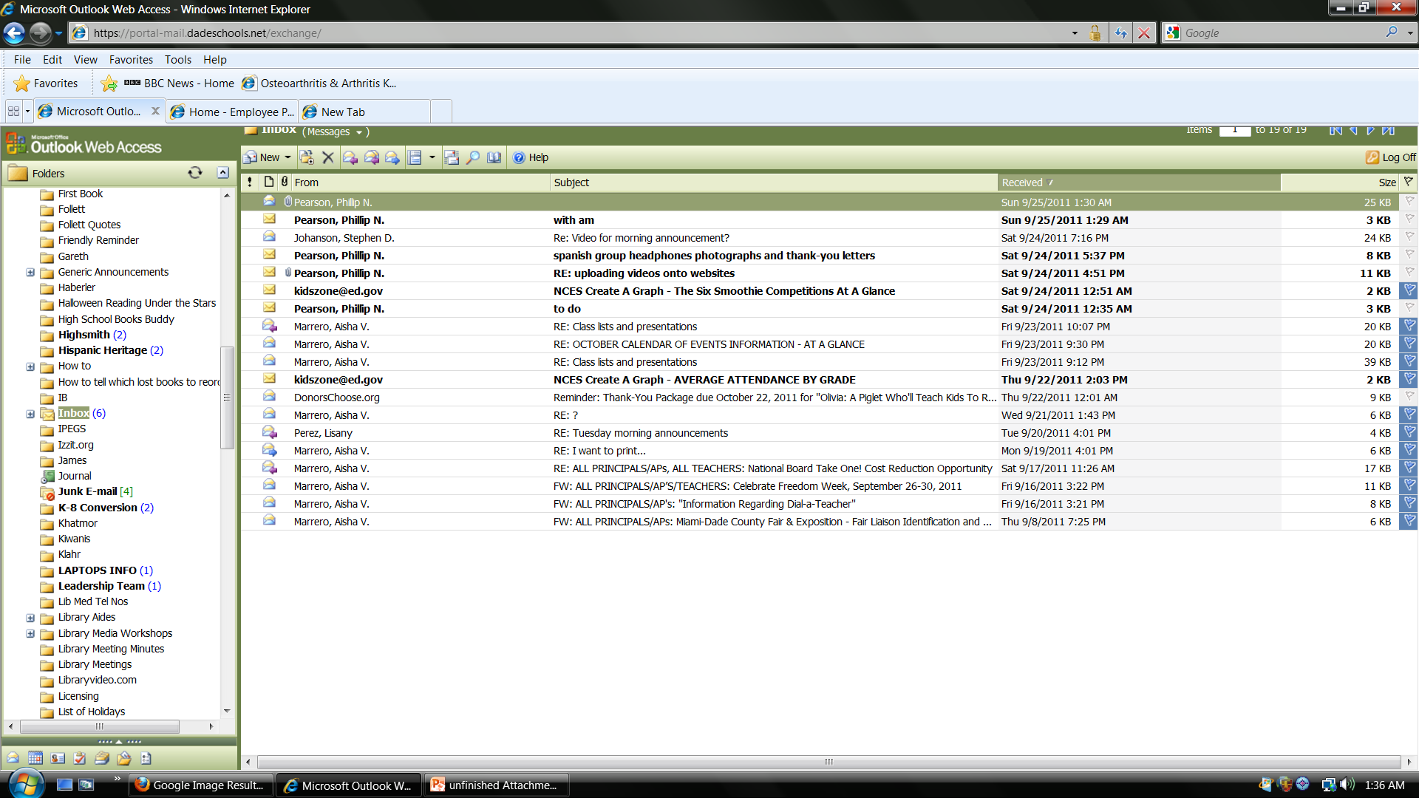
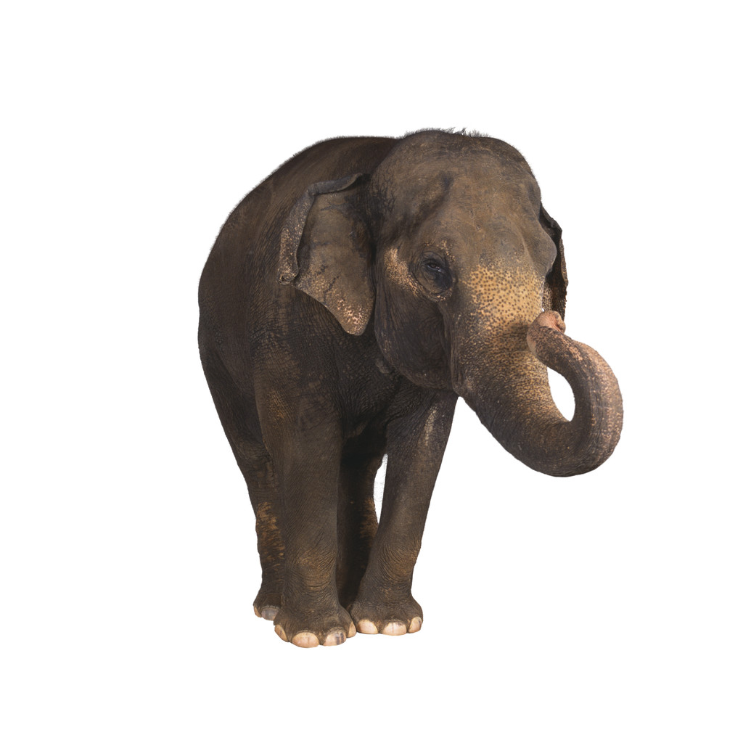
Did you ever find an elephant in your e-mail?

Slide 2

You know: a message that is so huge that it clogs everything else up…

Slide 3
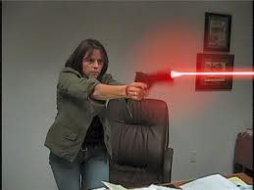
…and you can’t read or send anything else until you’ve DELETED it!

Slide 4
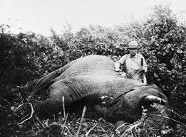
Often, people just ZAP giant e-mails without even reading them…

Slide 5
If you want to be SURE
…that people READ and KEEP the extra large documents / photos in your e-mails
use the Attachment Manager

Slide 6
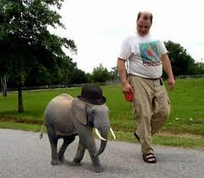
The ATTACHMENT MANAGER will shrink those photos / documents for you. HERE’S HOW

Slide 7
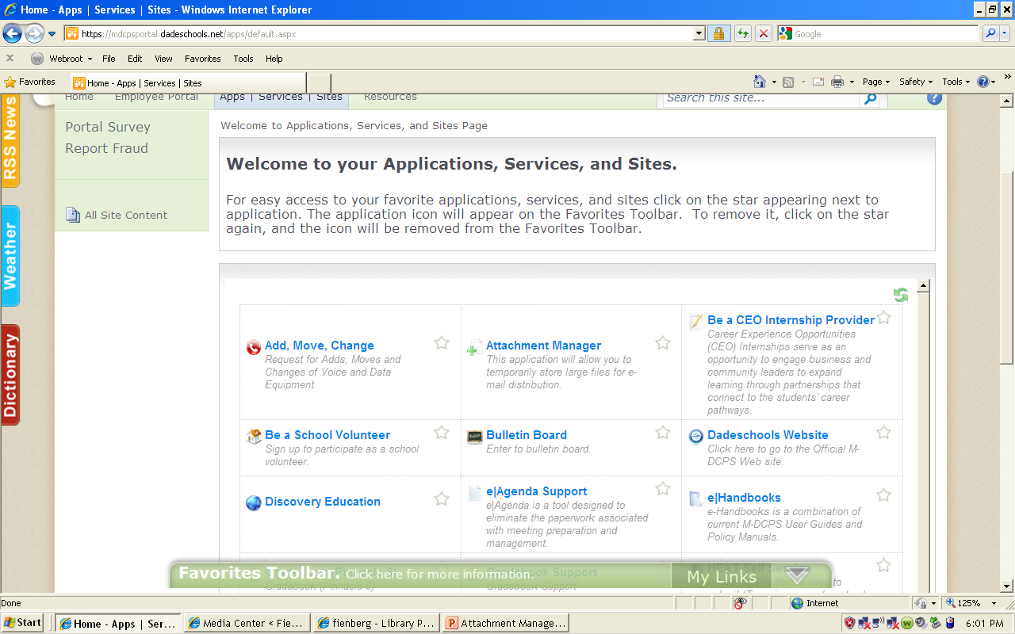
Click on Attachment Manager in your Employee Portal

Slide 8
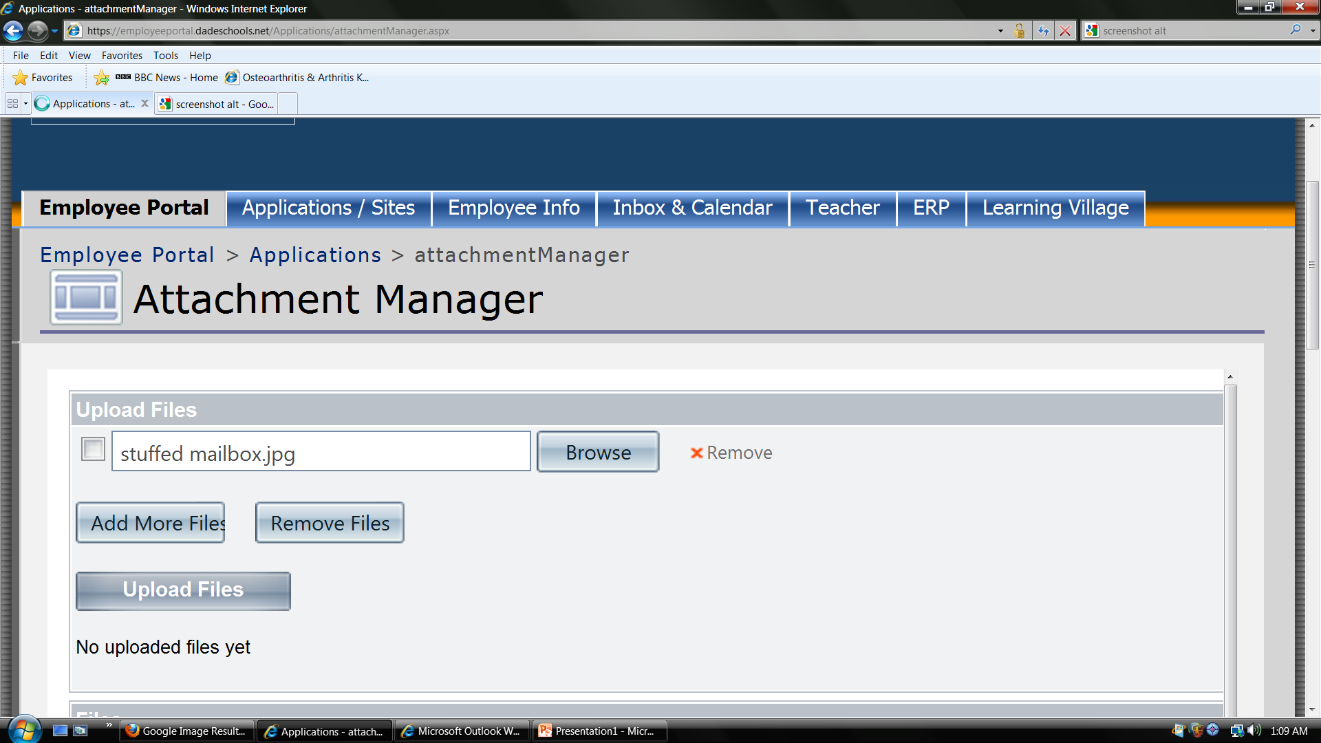
Browse PC for your attachment

Slide 9
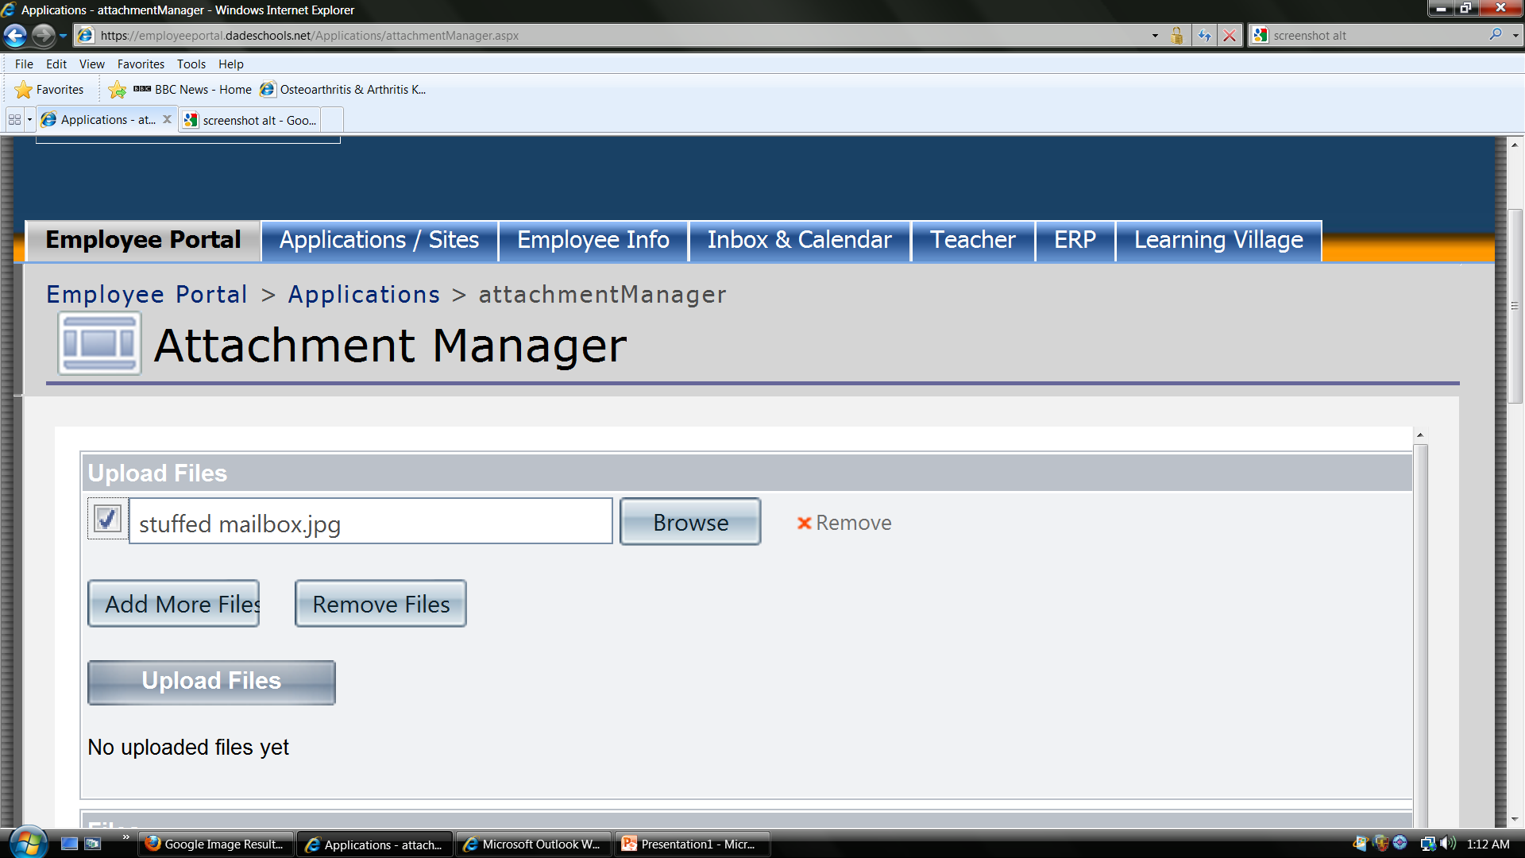
Check box and hit ‘Upload’

Slide 10
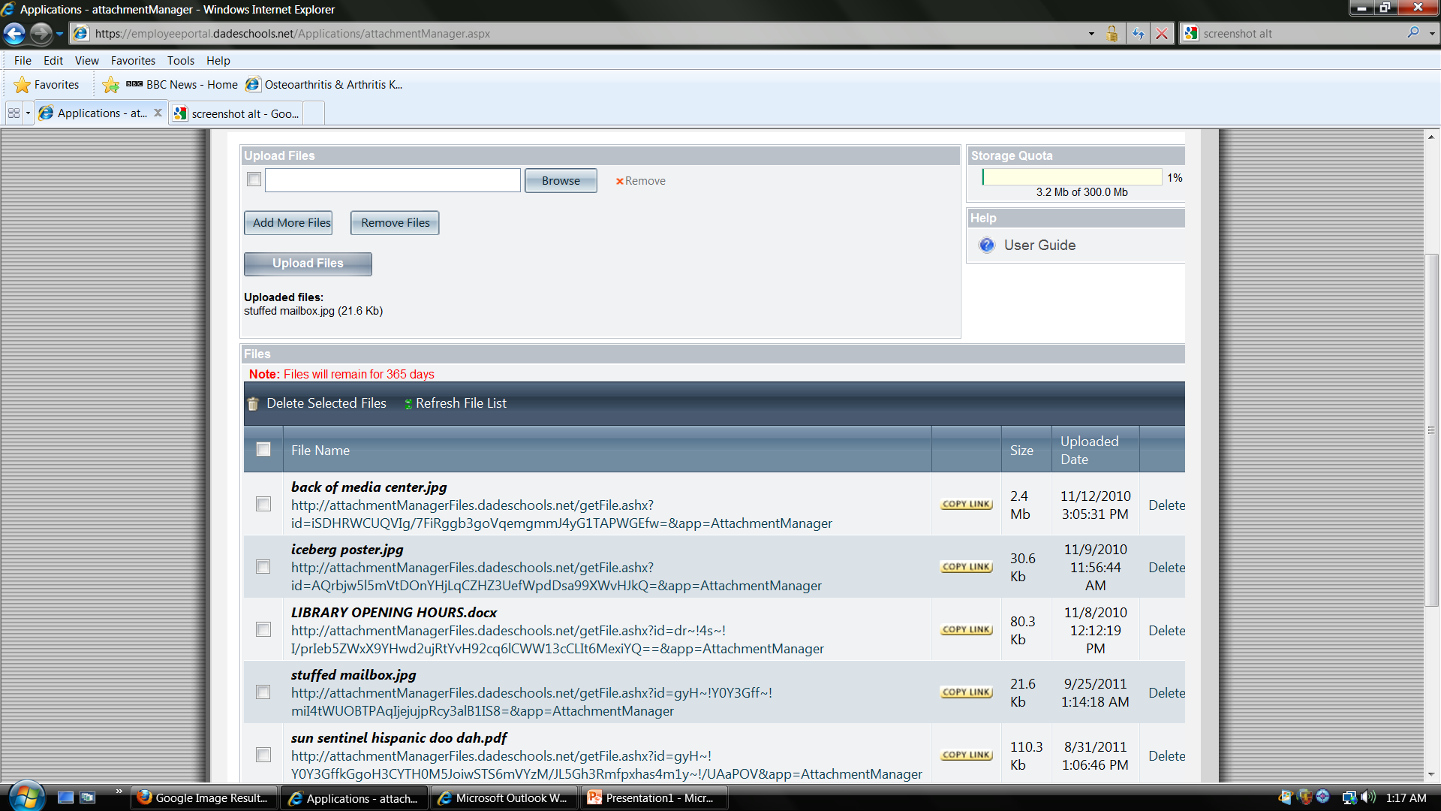
Find new attachment in list and click on ‘Copy Link’

Slide 11
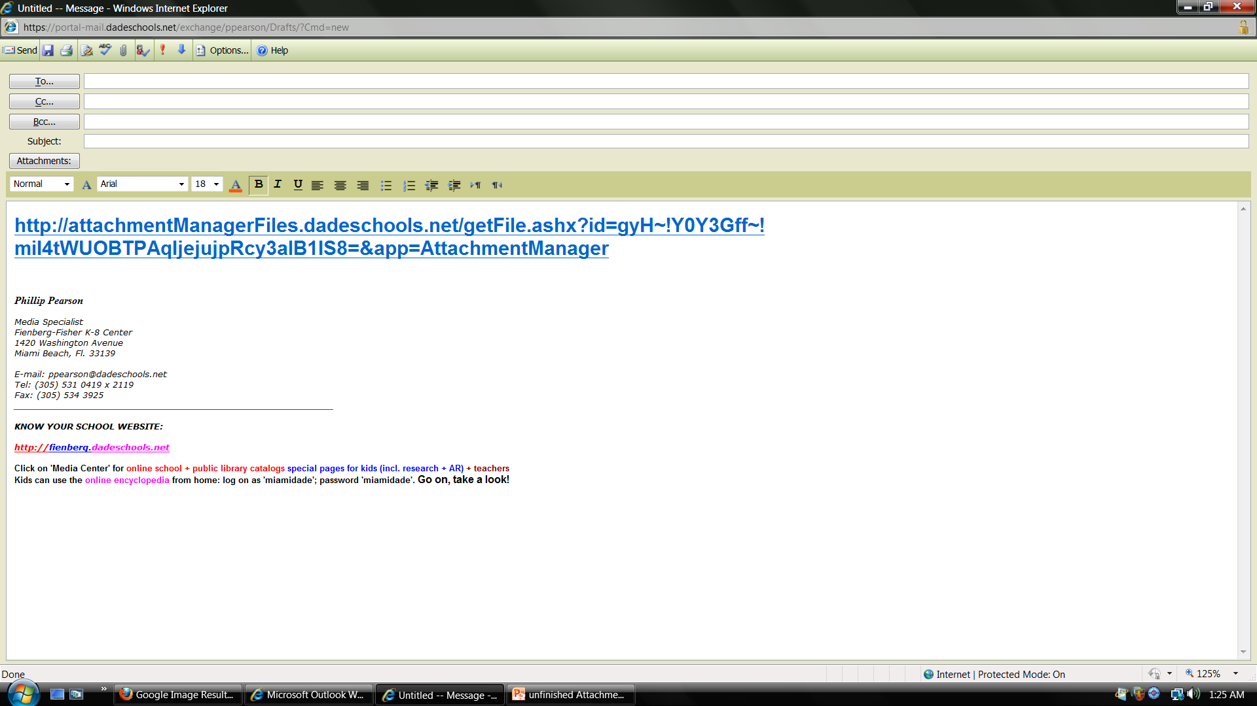
Paste link into your e-mail
And you’re done.
Ready to send!

Slide 12

Using Attachment Manager, it takes 3KB e-mail this document

Slide 13
NOT using Attachment Manager, it 95 KB – over 32 times as much space

Slide 14

Using Attachment Manager, it takes 3 KB to e-mail this picture

Slide 15

NOT using Attachment Manager, it takes 2 MB – over 600 times as much space

Slide 16

Get the message? Get the picture? No problems, right? Not if you use the ATTACHMENT MANAGER

